Slide 1

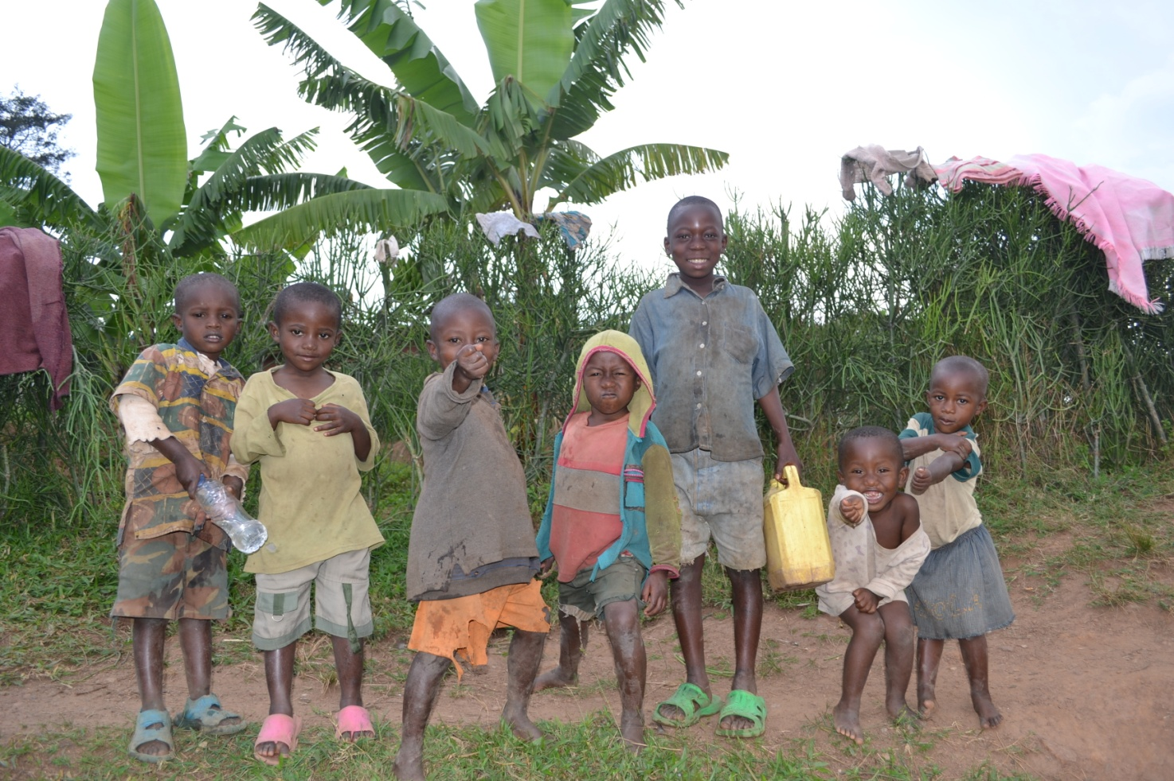
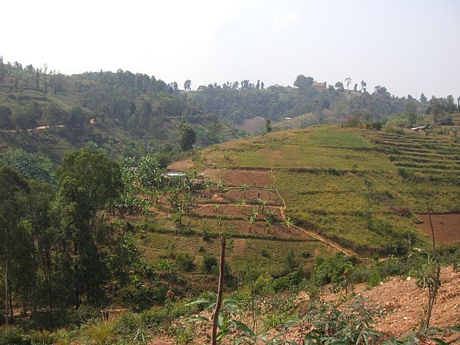
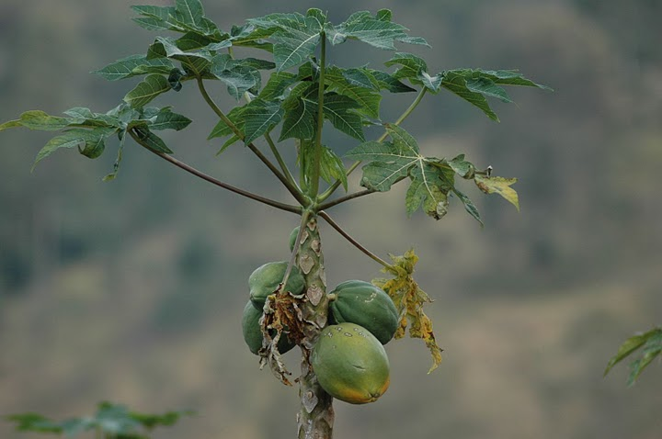
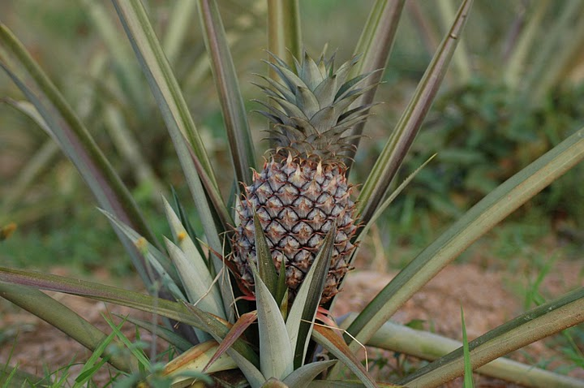
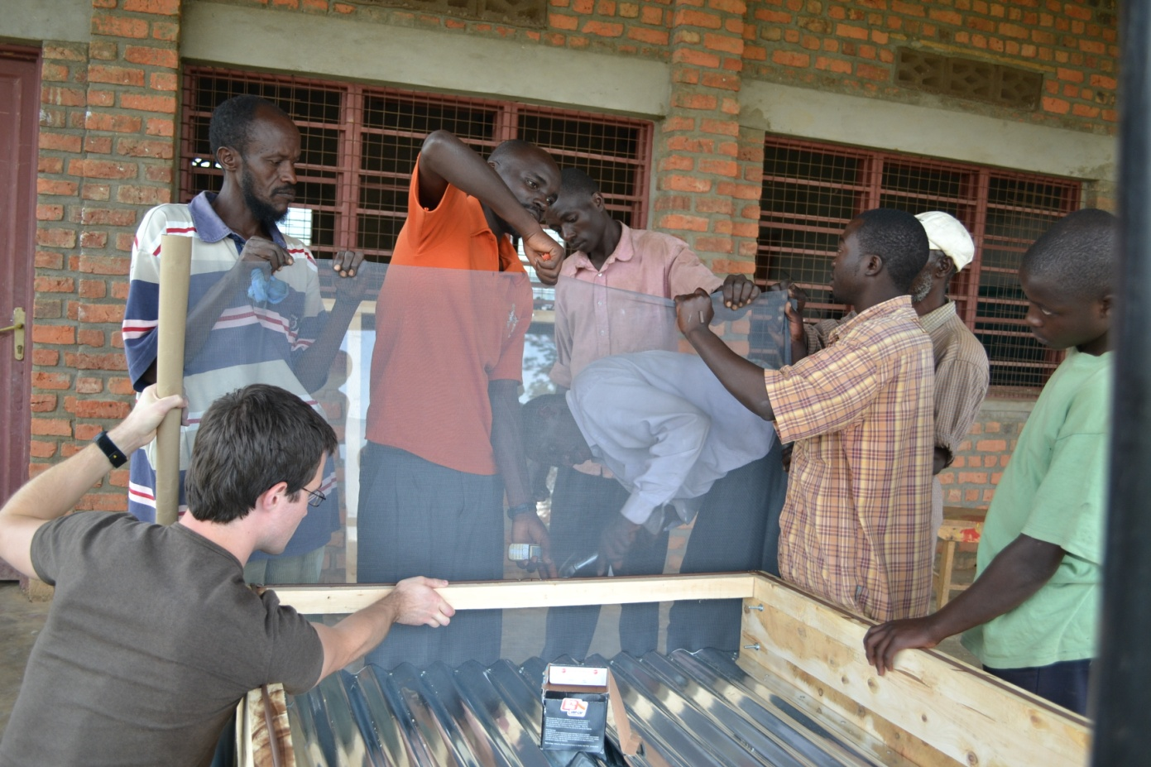
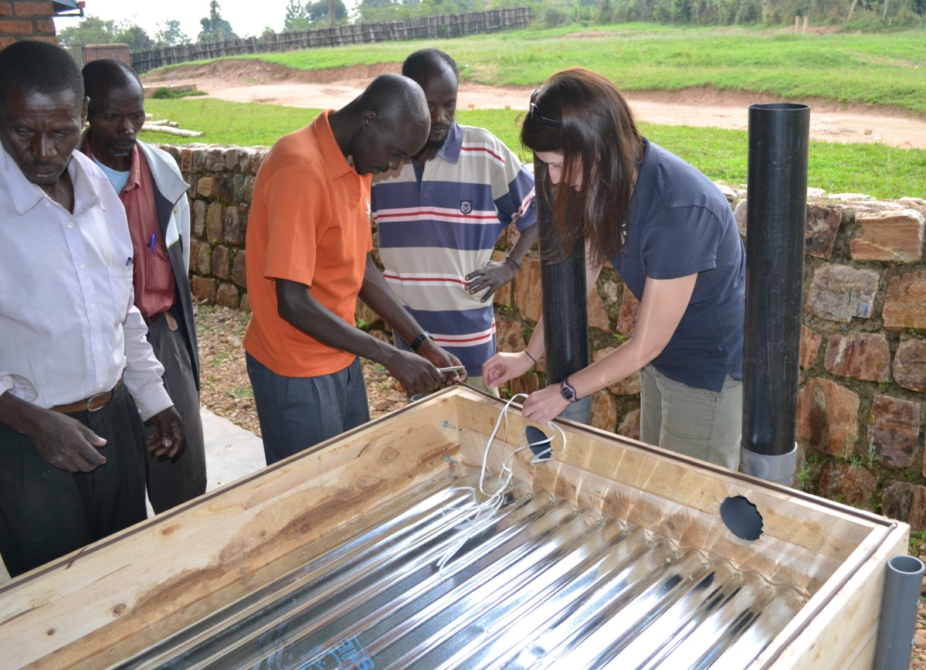
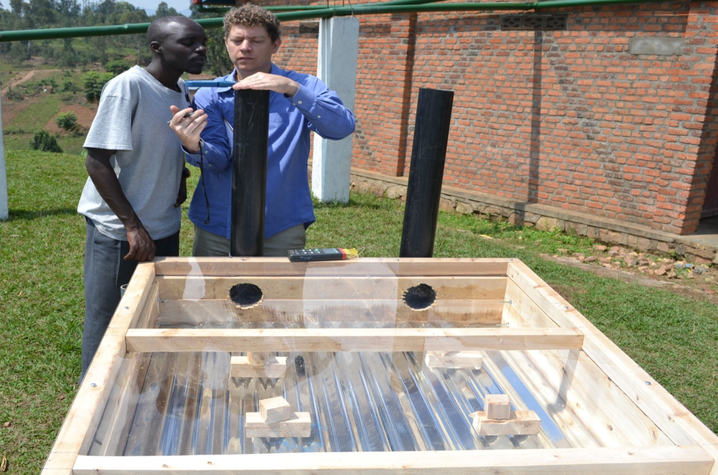
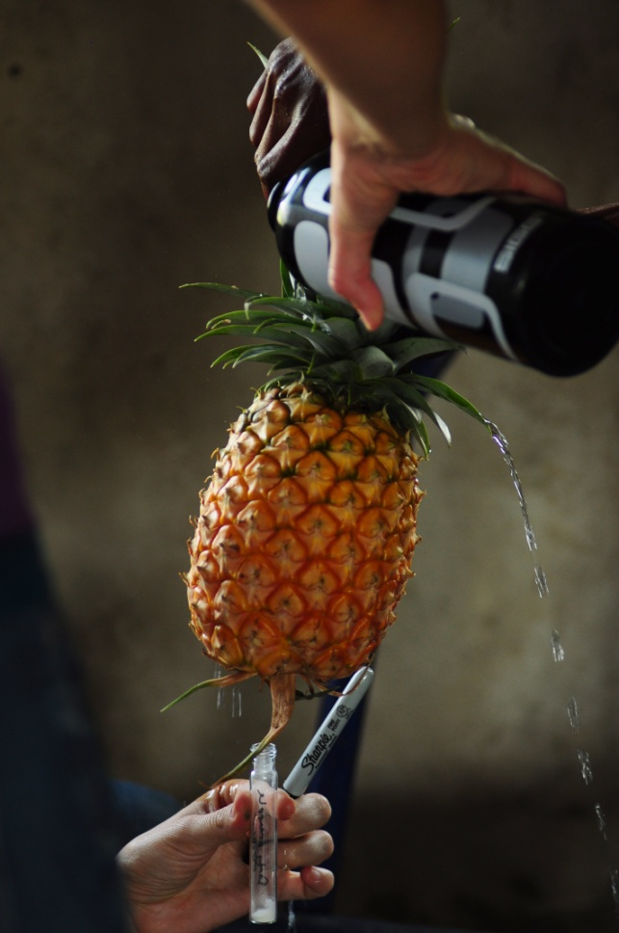
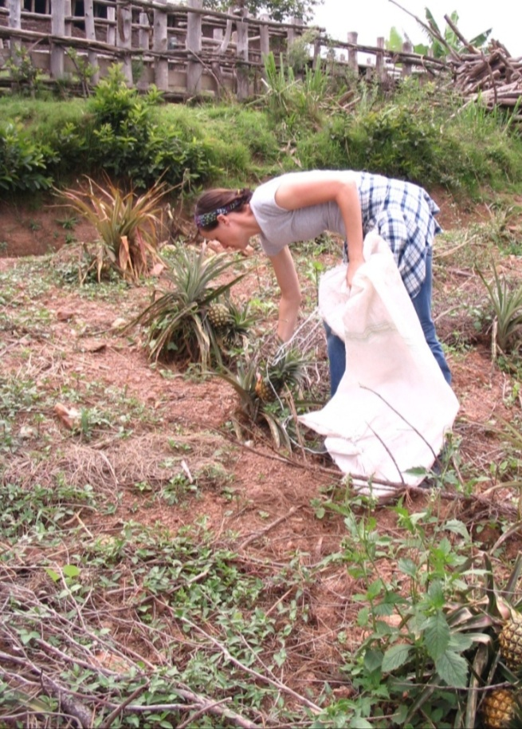
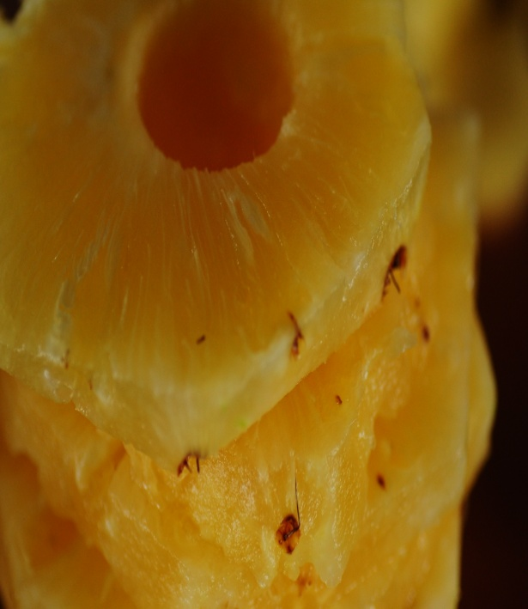
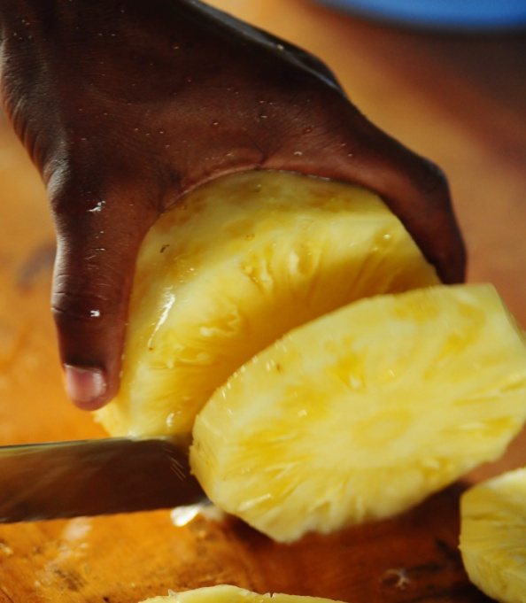
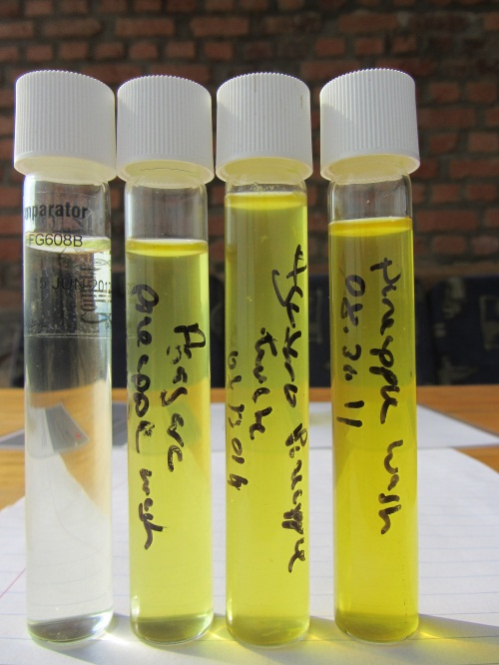
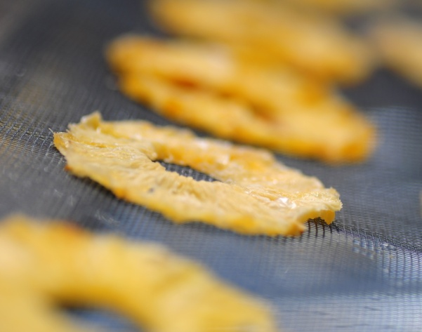
Fruit Drying for Orphans in Rwanda
The Engineers Without Borders Johnson Space Center (EWB-JSC) chapter is an association of JSC employees, contractors and other professionals in the Houston/Clear Lake area who volunteer their time to participate in sustainable projects in the developing world by addressing people's basic human needs and provide necessities by partnering with the local communities.
The EWB - JSC Chapter has been working with L’Esperance Children’s Aid Orphanage in Mugonero Rwanda since 2006. Having successfully provided a rainwater catchment system that provides additional water for the orphans and a rapid sand filtration water treatment BYOW system the orphanage has identified a new project for EWB-JSC.
To assist the orphanage in becoming economically sustainable the EWB-JSC chapter was asked to help design a system that could dry the large amount of fruit that the orphanage is growing in the surrounding hills. While a portion of the fruit grown goes towards feeding the orphans the extra will be used to dry and sell in the open market providing a source of income for the orphanage. Since the orphanage had not dried fruit before EWB-JSC began with a solar drying fruit system to begin teaching the orphanage staff how to process the fruit through a drying system as well as train them on potential sources of contamination of the fruit.
Fruit in the Mountains of Rwanda
Growing fruit in the mountains of Rwanda is not easy due to the slope of the ground but L’Esperance orphanage has been successful. They are currently growing pineapple, guava, and mango. They are growing enough fruit to harvest approximately 90kg a day which is more than enough to feed the 127 orphans and the orphanage staff and still have a large surplus to dry. EWB-JSC members were at the Mugonero orphanage in August/September 2011 installing a solar fruit drying system to begin training the orphanage staff on how to prepare and dry fruit.
EWB-JSC worked with local craftsman and orphanage employees to build 3 solar dryers and begin the training on drying fruit in the solar dryers. Due to Rwanda having 2 rainy seasons a year-round drying option is needed for the times where the solar dryer will not work. EWB-JSC is currently in work designing a year-round fruit drying system. That will be installed at the orphanage in the coming year.
Food Safety
Pineapple
Food safety refers to the conditions and practices that preserve the quality of food to prevent contamination and food borne illnesses
Food safety practices are regulated and must be followed in order to sell food overseas
Pineapple is harvested from the fields then washed, sliced, cored, placed in the dryer on racks dried and removed from the dryer
Mugonero, Rwanda

